Slide 1
Toughness
Developing True Strength On and Off The Field

Slide 2
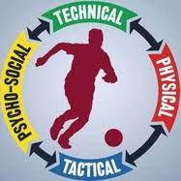
The Four Pillars of Soccer

Slide 3
Definition of Toughness
Being able to withstand great force without tearing or breaking. Something that is tough is strong and resilient.
Who do you imagine as a “tough guy”

Slide 4
Toughness Is a Skill
Toughness isn’t physical. It has nothing to do with size, physical strength or athleticism.
It’s an Intangible, an attitude, a philosophy.
Everyone can develop and improve their TOUGHNESS!!

Slide 5
10 Characteristics of Toughness
1- Trust
2- Preparation
3- Courage
4- Communication
5- Persistence
6- Next Play
7- Commitment
8- Acceptance
9-Resilience
10- Self-evaluation

Slide 6
Trust
Belief in a Common Goal – great teammates believe in what they are striving to accomplish, and what they are capable of doing together as a team.
Belief in Yourself- your team has good players!
Belief Through Adversity- How will you react when something is not going your way? Will you focus on the little things or will you feel sorry for yourself?

Slide 7
Preparation
Concentrate on what you’re doing while you’re doing it
One step at a time (goals, obstacles and personal plan)
Everything you do is important!!
Create a goal for every activity you do
Focus on your goals and not your destination

Slide 8

Courage

Slide 9
Communication
Toughness is about accountability, and tough players are willing to hold teammates accountable for the team’s standards, without worrying that a player will take criticism or a command the wrong way.
Teammates cannot fear hurting feelings, but have to trust that everyone is tough enough to accept that anything said is said in the best interests of the team’s performance and development.
“Are you tough enough to hold a teammate accountable to your team’s standards” –Grant Hill

Slide 10
Persistence
Your ability to keep going without giving up or giving in.
If you can be persistent in your belief, preparation, communication, your willingness to endure, and all of the other elements of mental toughness, you will be tougher.
Pushing limits- allow yourself to exceed a limit you thought you had.
Stepping out of your comfort zone.
Will you be the first one out there and the last one to leave the practice field?

Slide 11
Next Play
The game of soccer is simple, don’t allow it to be negative.
“by moving on to the next play, concentrating and trying to move to the next thing, you have a better chance to be your best at the moment” – Mike Krzyzewski

Slide 12
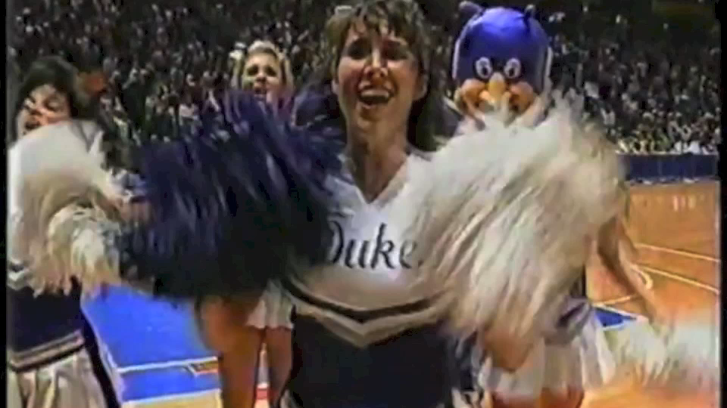
Next Play…

Slide 13
Commitment
Commitment to doing what it takes
Go to every class, sit up front and meet with professors
Put the team before yourself
Taking care of the little things on and off the field
Improving daily habits

Slide 14
Acceptance
To share, uphold and passing along the tradition of your program – PRIDE & TRADITION
The TEAM is the # 1 priority!
No matter what your role is, You are Important!
A tough player must determine what he would sacrifice to be apart of a special team. What task is too small? What role is beneath me? Is there anything I am not willing to do for this team to succeed, or for this team to operate at its highest level?
“WE” driven and not “ME driven”

Slide 15
Resilience
The ability to come back, to fight adversity or difficulties, is a measure of true toughness.
My beep test score was average, will I work hard enough to improve it by 2 levels?
Going to every class even when feeling sick or tired
Starting that review sheet days before the exam and not the night before
Will I take initiative during my summer internship?

Slide 16
Self-evaluation
Accept the challenge of looking in the mirror and, with a clear head and eyes, evaluating the most important person in your life: yourself
None of you have a ceiling, you have another step to take, another level to reach, another gear

Slide 17
Final Thoughts…
“I know that I am capable of true toughness. I believe we are all capable of exhibiting toughness. I also accept that I am not as tough as I want to be, and that I have to continue to strive, everyday, to be tougher- for my-self, my team and my family. Toughness isn’t about bravado. It is about meeting challenges head-on and not shrinking from them. And when I get knocked down, I strive to be tough enough to get up and keep fighting. Based upon those 10 principles, I know that I am tougher than I used to be, and I can and will be tougher tomorrow than I am today”.
                -Jay Bilas

